Slide 1
NYSSLS: Standards to Curriculum
Joyce Barry, Science, Research & Technology Chairperson
Plainview-Old Bethpage School District
jbarry@pobschools.org
Mary Loesing, Ed.D., STEM Chairperson
Connetquot Central School District
mloesing@ccsdli.org
Notes:
Picture with reflected caption
(Basic)
To reproduce the picture effects on this slide, do the following:
On the Home tab, in the Slides group, click Layout and then click Blank.
On the Insert tab, in the Images group, click Picture. In the Insert Picture dialog box, select a picture, and then click Insert.
Under Picture Tools, on the Format tab, in the Size group, click the Size and Position dialog box launcher. In the Format Picture dialog box, resize or crop the image so that the height is set to 3.17” and the width is set to 10”. To crop the picture, click Crop in the left pane, and in the right pane, under Crop position, enter values into the Height, Width, Left, and Top boxes. To resize the picture, click Size in the left pane, and in the right pane, under Size and rotate, enter values into the Height and Width boxes.
Select the picture. On the Home tab, in the Drawing group, click Arrange, point to Align, and then do the following:
Click Align to Slide.
Click Align Top.
Under Picture Tools, on the Format tab, in the Picture Styles group, click Picture Effects, point to Reflections, and then under Reflection Variations click Half Reflection, touching (first row, second option from the left).
On the Insert tab, in the Text group, click Text Box, and then on the slide, drag to draw the text box.
Enter text in the text box, select the text, and then on the Home tab, in the Font group, select Impact from the Font list and then enter 42 in the Font Size box.
On the Home tab, in the Paragraph group, click Align Text Right to align the text right in the text box.
Select the text box. Under Drawing Tools, on the Format tab, in the WordArt Styles group, click Text Effects, point to Reflection, and then under Reflection Variations click Half Reflection, touching (first row, second option from the left).
Under Drawing Tools, on the Format tab, in the WordArt Styles group, click the Format Text Effects dialog box launcher. In the Format Text Effects dialog box, click Text Fill in the left pane, select Solid fill in the Text Fill pane, and then do the following:
Click the button next to Color, and then under Theme Colors, click White, Background 1 (first row, first option from the left).
In the Transparency box, enter 12%.
On the slide, drag the text box onto the picture to position as needed.
To reproduce the background on this slide, do the following:
Right-click the slide background area, and then click Format Background. In the Format Background dialog box, click Fill in the left pane, select Gradient fill in the Fill pane, and then do the following:
In the Type list, select Radial.
Click the button next to Direction, and then click From Center (third option from the left).
Under Gradient stops, click Add or Remove until two stops appear on the slider.
Also under Gradient stops, customize the gradient stops that you added as follows:
Select Stop 1 from the list, and then do the following:
In the Stop position box, enter 10%.
Click the button next to Color, and then under Theme Colors click White, Background 1, Darker 5% (second row, first option from the left).
Select Stop 2 from the list, and then do the following:
In the Stop position box, enter 99%.
Click the button next to Color, and then under Theme Colors click White, Background 1, Darker 35% (fifth row, first option from the left).

Slide 2
What is the current state of science standards in NYS
Currently, the NYS standards that are in place are the MST Standards that were introduced in 2000.
Science content and pedagogy have changed since 2000 necessitating the need for new standards.
In 2013 the Next Generation Science Standards were released. Currently 16 states have adopted them, many more have adapted them.
NYS has adapted the NGSS to create the New York State Science Learning Standards (NYSSLS).

Slide 4
NGSS Adoption Map

Slide 5
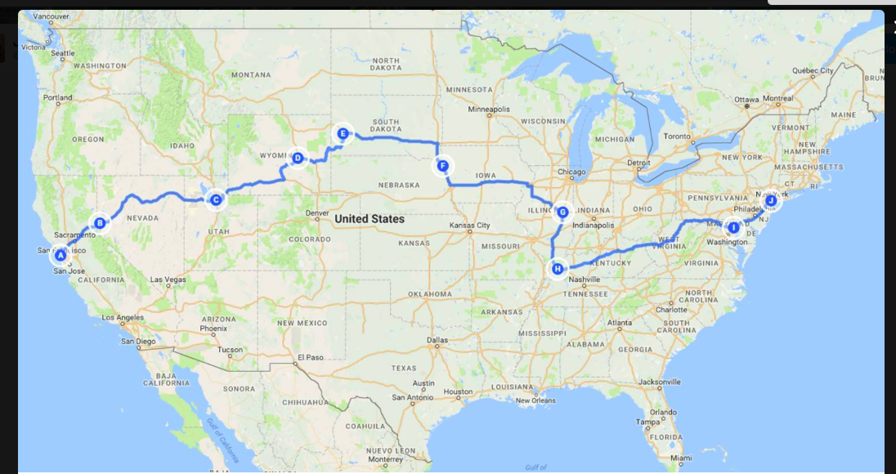
You Can Now Travel from the Atlantic to the Pacific with Three Dimensional Learning

Slide 6
How are the NYSSLS different than our current standards?
Current MST | NYSSLS
Mostly teacher led activities with known outcomes | Students plan and carry out investigations – “real science”
Emphasis on content (Standard 4) | Emphasis on practices including engineering, critical thinking and explanation of phenomena
Any units 5-8 | Specific units, banded K-2, 3-5, and 6-8, Progressions K-12
Familiar | Some unit content new to most teachers K-8
Assessments - recall | Performance tasks – application/evaluation/models/ analysis
Grades/courses taught in isolation | College/career ready, K-12 progressions

Slide 7
NYSSLS
New York State Science Learning Standards
Adapted from the NGSS
First Draft Released in 2015
Stakeholder comment period resulted in several changes
Second Draft Released in 2016
An item will be placed before the Board of Regents to adopt these standards this fall.
http://www.p12.nysed.gov/ciai/mst/sci/documents/BoR-ConsiderationNYS%20P-12-ScienceLearningStandards.pdf

Slide 8
What are the implications for how science should be taught
The NYSSLS contain less content, but greater depth, than our current standards.
This will result in a new way of teaching and learning science.
Content (Disciplinary Core Ideas) is meant to be taught along with the Cross-Cutting Concepts and Science and Engineering Practices.
Together these three components comprise three dimensional (3D) learning.
Students learn content through investigating questions, rather than listening to lectures and memorizing information.
Teachers move into the role of facilitator.

Slide 9
System Architecture
Performance
Expectations
Foundation
Boxes
Connection
Box

Slide 10
How Do NYSSLS Differ from NGSS
All additions to the NGSS are highlighted in yellow.
Preschool standards have been added.
Very few additions have been made to the K-5 standards.
Fourteen changes have been made to the secondary standards, the majority of the changes are in the physical sciences.
Performance expectations contain assessment boundaries to guide curriculum development as to what is age/grade level appropriate.

Slide 11
Disciplinary Core IDEAS
Disciplinary Core Ideas outline the content that is included in the performance expectation.
For any PE that was added by NYSED, a corresponding DCI has also been added.
The DCIs will be especially helpful for elementary teachers who may not have as much science content knowledge as secondary teachers.

Slide 12
Science & Engineering practices
SEPs outline the practices that students should be engaging in as they learn science.
Asking Questions and Defining Problems
Developing and Using Models
Analyzing and Interpreting Data
Engaging in Argument from Evidence
Using Mathematical and Computational Thinking
Constructing Explanations and Designing Solutions
Planning and Carrying Out Investigations

Slide 13
Cross-Cutting Concepts
CCCs are connections between science content as well as between science and other disciplines
Cause and Effect
Scale, Proportion and Quantity
Systems and System Models
Structure and Function
Stability and Change
Energy and Matter
Patterns

Slide 14
Evidence Statements
Evidence statement show how students can demonstrate that they have met the performance expectation.
Evidence statements are not curriculum, but can be used to guide the development of curriculum.

Slide 15
Progressions
Progressions show how the content spirals throughout the grade levels, becoming more detailed and complex as students get older and more mature as learners.
Progressions allow teachers to see what students should know when they come into each grade band, so there should be less repetition of content.

Slide 16
Three dimensional learning
https://www.teachingchannel.org/videos/transition-to-ngss-achieve
Use phenomena and/or storylines to show students that the science that they are learning about is part of the “real world”.
Have students develop questions based on the phenomena.
Students can design investigations to answer their questions.
Teachers, as facilitators, listen and watch what students are doing and saying, they ask questions, and note misconceptions that can be addressed at the time, or during large group instruction.

Slide 17
Three dimensional teaching
Combines content with science and engineering practices and cross-cutting concepts.
Gives students more responsibility for what they are learning.
Teacher serves as facilitator.
Begins with the students conducting an experiment and analyzing their findings to uncover the core concepts of the unit.
Experiments can be simple or complex depending upon where in the year the lesson takes place as well as on the level of the students.

Slide 18
What should we do now??
Introduce your teachers to the standards, if they have not already seen them.
Don’t wait to begin to make changes to your curriculum.
Suggestion – pick a unit from our current standards and transform it to an NGSS/NYSSLS aligned unit.
Determine which standards the unit will address.
Identify the SEPs and CCCs that will be incorporated into the unit.
Start with a phenomena or real world scenario and have students develop a question to investigate.

Slide 19
NYSSLS Curriculum
Give your teachers time to develop, teach, revise and give feedback on each unit that is developed.
Use the NGSS Evidence Statements to guide lesson development to ensure that students achieve the performance expectation.
Use the many resources that are available online to help guide lesson and assessment development.
Look to states like Massachusetts and California that have begun implementation for ideas.

Slide 20
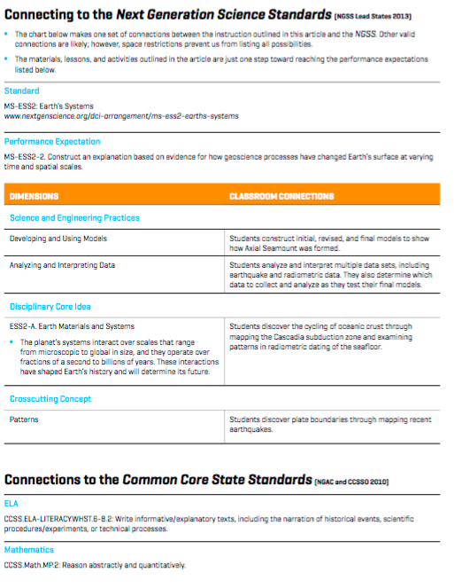

Slide 21
Implementation timeline for nyssls
Timeframe | Task
Summer and Fall 2016 | Outline a more detailed transition strategy for the new NYS P-12 Science Learning Standards in alignment with the Statewide Strategic Plan for Science
Fall 2016 | Present NYSSLS to BOR for adoption.
2016-2017 School Year | Build awareness of NYSSLS across the state. Develop and propose assessment frameworks.
2017-2018 School Year | Continue building awareness and building capacity across the state. Local implementation begins. Assessment development focuses on item prototyping and early item writing.

Slide 22
Implementation timeline, cont.
Timeframe | Task
2018-2019 School Year | Continue local implementation. Assessment development focuses on item writing and ancillary test development activities.
2019-2020 School Year | Continue local implementation. Assessment development focuses on the final item writing for items that will appear in the first 2020-2021 test. Field testing, a question sampler and public information will be released.
2020-2021 | Reexamine and revise Strategic Plan as necessary. Earliest possible administration of grade 5 and 8 assessment. Field testing of Regents exam items.
2021-2022 | Proposed administration of new Regents exams.

Slide 23
Resources
http://www.p12.nysed.gov/ciai/mst/sci/documents/BoR-ConsiderationNYS%20P-12-ScienceLearningStandards.pdf
NGSS@NSTA
www.nextgenscience.org
http://www.cde.ca.gov/pd/ca/sc/ngssstandards.asp
http://www.doe.mass.edu/stem/standards/faq.html
NYS Science Consortium PowerPoints
NGSS Overview for Principals http://www.nextgenscience.org/sites/default/files/resource/files/NGSS%20Overview%20for%20Principals_0.pdf

